Slide 1






A practical introduction to programming the Cerebras CS-2 for HPC workloads
Nick Brown
EPCC University of Edinburgh
Joseph Lee
EPCC University of Edinburgh
Leighton Wilson
Cerebras Systems

Slide 2
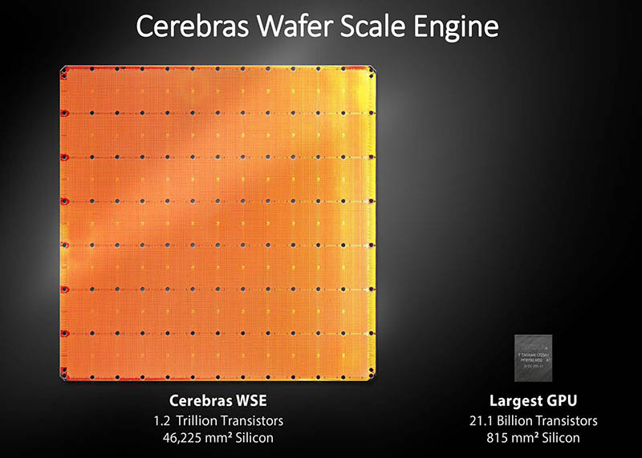
Motivation
HPC w
CS-2 solves this by ….

Slide 3
Learning objectives
This tutorial is open to everybody, regardless of experience with HPC and accelerators
Is practically driven, where we will walk-through key concepts on the machine itself, and then explore the concepts in combination via a series of walk-throughs
Understand the CS-2 architecture & core concepts
We will explore the hardware, how it is designed the and type of workloads it suits
Get started with the Cerebras SDK
Exploring key concepts for writing HPC codes for the CS-2 and understanding how to build these
Write simple program (Single Tile GEMV, Multi tile program)
Bringing the concepts together and using these to develop a real code for the CS-2 and optimise it
Running on Simulator
Much of development is done with a simulator, we will explore how to use this and leverage it when writing code
Optimize performance (DSD, SIMD, memory banks)
Once we are comfortable with writing codes for the CS-2, we want them to run fast! Exploring techniques for doing this
Debug library
Sharing with you how to go about debugging your code for the CS-2
Running on real hardware
Ultimately we want to accelerate our HPC codes on the CS-2, we will run our hands-on exercises on a real CS-2 machine

Slide 4
Session plan
More about the hands on activities in about 50 minutes!

Slide 5
Materials and the CS-2 community
We will remind people as we progress through the session
All materials for this tutorial are open source and can be found at
https://github.com/EPCCed/cs2-sdk-training
More generally if you wish to continue exploring this after the tutorial finishes:
https://sdk.cerebras.net/csl

